Slide 1
Boundary value analysis Goals, Examples CSE435

Slide 2
Boundaryvalueanalyze
A boundary value:
an input value or output value which is on the edge of an equivalence partition or at the smallest incremental distance on either side of an edge, for example the minimum or maximum value of a range.
What is Boundary value analyze (BVA)?
Is a technique to refine equivalence partitioning based on testing at the boundaries between partitions

Slide 3





Boundaryvalueanalyze
Equivalence classes
Boundary values

Slide 4
Boundaryvalueanalyze
Goals:
Find errors associated with the boundary values
Test levels:
•
•
•
Unit Integration System
This technique is based on the risks:
•
•
A large number of problems occur at the boundaries of the input variables
Even if found equivalent classes correctly, boundary values may be incorrectly assigned to another class.

Slide 5
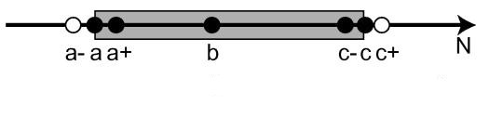
Boundaryvalueanalyze
Test case design by BVA proceeds into 3 steps:
•
•
•
Determine the range of values (usually it is equivalence class) Determine boundary values
Check input variable value at the
minimum,
just above minimum,
just below minimum,
normal,
at the maximum,
just below maximum,
just above maximum

Slide 6


Boundaryvalueanalyze
Example: bank has different charges depending on the transaction done.
•
•
5% of the amount for transaction less than or equal to 1000
6% of the amount for transaction more than 1000 and less than or equal to 2000
7% of the amount for transaction more than 2000
•

Slide 7
Boundaryvalueanalyze
Example: Password field can not be shorter than 4 and longer than 28 (including) characters (numeric and alphabetic)
Equivalance classes
Boundary Values
0-3
4-28
28+1
{-1;0;1}, {2;3;4}
{3;4;5}, {27;28;29}

Slide 8
Boundaryvalueanalyze
Example:The program selects candidates for military service focusing only on age (not less 18 and no more 25)
Conscription in the army
Not conscription Conscription Not conscription
17 18 25 26
Boundary values: {17;18,19} {24;25;26}

Slide 9
Boundaryvalueanalyze
Example: In a system designed for postal services' payment: Letters up to 100g are called as ‘light’.Postal rates for sending the light letters up to 10g are
$25. The next 40g should be played by $35. Each next 25g up to 100g should be played by an extra $10. Partitions should be designed for “grams”.
Equivalance classes: Boundary Values
0 – 9g: 25$
10-49g: 35$
50-74g:10$
75-99g: 10$
100+1g: not a light
letters
{-1, 0, 1}, {8, 9, 10},
{9, 10, 11}, {48,49,50}
{49, 50, 51}, {73,74,75}
{74,75,99}, {98,99,100}
{99,100,101}

Slide 10
Boundaryvalueanalyze
Example: we test module for HR, which determines to hire the candidate or not, based on the age of the candidate:
•
•
•
•
0-16 (Do not Hire);
16-18 (Can hire only part time );
18-55 (Can hire on full time); 55-99(Do not Hire)
Equivalance classes:
0-15: Do not Hire
Boundary Values
{-1, 0, 1}, {14, 15, 16},
16-17: Can hire only part time 18-54: Can hire on full time 55-99: Do not Hire
{17, 18, 19},
{54, 55, 56},
{98, 99, 100}

Slide 11
Decision Table testing
A decision table is basically an outstanding technique used in both testing and requirements management. It is a structured exercise to prepare requirements when dealing with complex business rules.
A decision table lists causes and effects in a matrix. Each column represents a unique combination.
Cause | Inputs1 | Inputs2 | Inputs3 | Inputs4 | Inputs5
Cause1 | Y | Y | Y | Y | N
Cause2 | Y | N | N | Y | N
Cause3 | Y | N | Y | N | N
Effect
Effect1 | X | X |  | X
Effect2 |  |  | X |  | X

Slide 12
An Example: Withdrawing money from bank

Slide 13
Step1: analyze the requirement to create the first column
Requirement: “Withdrawal is granted if requested amount is covered by the balance or if the customer is granted credit to cover the withdrawal amount”
Express conditions and resulting actions in a list so that they are either TRUE or FALSE.
In this case there are two conditions, “withdrawal amount ≤ balance” and “credit granted”. There is one result, the withdrawal is granted.

Slide 14
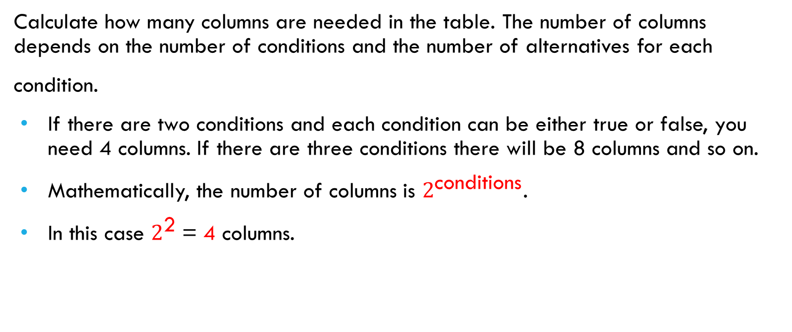
Step 2 : add Colum
Calculate how many columns are needed in the table. The number of columns depends on the number of conditions and the number of alternatives for each
condition.
If there are two conditions and each condition can be either true or false, you need 4 columns. If there are three conditions there will be 8 columns and so on.
Mathematically, the number of columns is $2^{\text{conditions}}$.
In this case $2^{\text{2}}$= 4 columns.

Slide 15
Reduce the table
Mark insignificant values with “-”. Invalid combinations are those that cannot happen, for example, that someone is both an infant and senior. Mark them somehow, e.g. with “X”.
If the requested amount is less than or equal to the account balance it does not matter if credit is granted. You may delete the columns that have become identical.

Slide 16
Step 4: determine action
Enter actions for each column in the table according the requirement.
They may be named R1/Rule 1, R2/Rule 2 and so on, but can also be given more descriptive names

Slide 17
Thank you!

